Slide 1

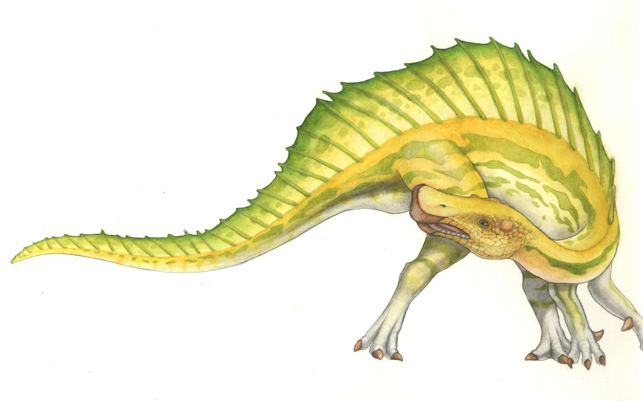
Operating Systems BSE- 5B
Lecture 1
Date: 22-08-2023
Introduction

Slide 2
Myself
RUBAB ANAM JANJUA
Email: rubab.anam@nu.edu.pk
Office Num: E-229
FAST School of Computing, FAST-NUCES, Lahore.

Slide 3
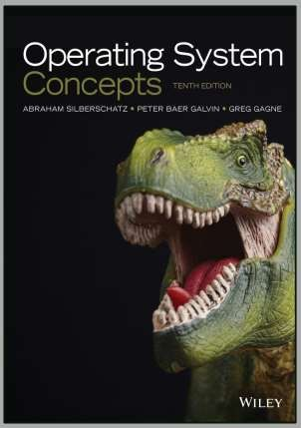
Books and Resources
● Operating System Concepts 10th Edition by Silberschatz, Galvin and Gagne

Slide 4
Course outline
Introduction
Processes, Inter-process communication,
Threads
Synchronization, Semaphores,
Deadlocks
CPU Scheduling
Memory management
File-system management
 ……

Slide 5
Class Rules & Regulations
Quizzes
All quizzes will be Announced
Quizzes will have more weightage as compared to Assignments
Assignments
In case of copied, all remaining assignment will be marked Zero
Avoid late submission, No assignment will be entertained after deadline
Don’t send me assignments by using email, submit them on Google Class
Attendance
Don’t mark Proxy of your friend (If he/she is your real friend ☺)
 In case of proxy, 5 Absents will be marked to that student
In case of emergency, get permission personally or send an email prior to the class
Attend all classes regularly, no attendance issue will be entertained in the end of semester

Slide 6
Class code
xdmj2ft
Display
Class code
2mbuiqy

Slide 7
Are you ready !!!!
Lets Begin

Slide 8
Operating Systems
How is RAM managed?
How do you find something on disk?
How do you know where to load it in RAM?
How do you keep track of all running programs?
Answer
■ This is what the operating system does

Slide 9
What is an Operating System?
A program that acts as an intermediary between a user of a computer and the computer hardware
Operating system goals:
Execute user programs and make solving user problems easier
Make the computer system convenient to use
Use the computer hardware in an efficient manner

Slide 10
What is an Operating System?
It is a program!
User’s view
Provides an extended or virtual machine abstraction to user programs
Easier to program than the underlying hardware
All services are invoked and accomplished through system calls
System view
Acts as a resource manager of a complex system
Resources consist of processors, memories, timers, disks, keyboard, network interfaces, printers etc.
OS manages allocation of these resources to user programs in an orderly and controlled manner

Slide 11
What is an Operating System?
OS do nothing by themselves
Similar to subroutine libraries, do nothing unless they are invoked by programs
Act as an intermediary between users and the hardware

Slide 12
Two Goals of Operating Systems
Manage hardware resources
System operates smoothly, efficiently, reliably and securely
Present abstract system model to programmer
Simple and convenient access to and control of resources

Slide 13
Manager/Coordinator of Resources
Coordinates who gets what
“who”: running programs
“what”: resources
“when”: scheduling time
“where”: organizing space
“whether”: limits, rights
Goal: smooth system operation
efficiency, reliability, security

Slide 14
Resource multiplexing
OS multiplexes resources in two ways:
In time
Time multiplexing involves different programs taking turns in using the resource.
Example:
CPU scheduling
printer sharing
In space
Space multiplexing involves different program getting part of the resource possibly at the same time
Example:
memory is divided into several running programs

Slide 15
What If No Operating System?
All we have is bare hardware
You want to run a program
How do you load it?
How do you run it?
What happens when it completes?
Need at least some minimal OS to do these functions

Slide 16
…Lets go back to the “stone age”
of computing…

Slide 17
Early Systems
No Operating systems,
your Data and your Programs
 X = X + 1;
As
Register1, x
Load
Load Direct
Add
Store
Register2, 1
Register3, Register2, Register1 Register3, x
Time slots allocated to scientists
Enter programs using binary switches

Slide 18
Early Systems
Problem:
computer remains idle while programmer sets things up
Poor utilization of huge investment
Solution:
Hire a specialized person to do setup
Problem:
Faster than programmer, but still a lot slower than the machine
Solution:
Build a batch monitor

Slide 19
The Monitor
The monitor is the special program that manages the sequential execution of jobs in a batch.
Early batch system
bring cards to 1401
read cards to tape
put tape on 7094 which does computing
put tape on 1401 which prints output

Slide 20
Simple Batch System
The user submits a job (written on a card or tape) to a computer operator
The computer operator place a batch of several jobs on a input device
A special program, the monitor, manages the execution of each program in the batch
Resident monitor is in the main memory and available for execution

Slide 21
The Resident Monitor
Monitor reads job one at a time from the input device
Monitor places a job in the user program area
A monitor instruction branches to the start of the user program
Execution of the user program continues until:
End of program occurs
Error occurs

Slide 22
Why study operating systems?
Point of describing change isn’t “Look how stupid batch processing is” – it was right for tradeoffs of the time, but not anymore
Point is: have to change with changing technology
Situation today is much like it was in the late 60’s
OS’s today are enormous, complex things
100k's of lines (or >1M lines)
Windows NT is 20M lines
Windows2000 and Windows XP are about 40M lines.
Key aspect of this course, understand OS’s so we can simplify them!

Slide 23
Beyond batch processing systems
The Era of Timesharing and Multiprogramming
Multiprogramming-Execute multiple jobs simultaneously
Timesharing-Processor’s time is shared among multiple users

Slide 24
Multiprogramming
Execute multiple jobs simultaneously
But a CPU can execute a single instruction at a time???
One job can use the CPU while the other is waiting for I/O
Small jobs not delayed by large jobs
Context switching

Slide 25
Requirements for Multiprogramming
Hardware support:
I/O interrupts and (possibly) DMA(Direct memory access)
OS requests I/O, goes back to computing, gets interrupt when I/O device finishes
Memory management
several ready-to-run jobs must be kept in memory
Memory protection (data and programs)
Software support from the OS:
Job Scheduling
Which ready jobs should be brought to memory
CPU Scheduling
Which program is to be run next

Slide 26
Multiprogramming
What is the Performance criteria?
Turn-Around Time
 The length of time between the start of the job and when the output was done

Slide 27
Time Sharing System (TSS)
Processor’s time is shared among multiple users
Use cheap terminals to let multiple users interact with the system at the same time
OS does timesharing to give illusion of each user has own computer

Slide 28
Time Sharing System (TSS)
Time sharing was achieved by resource sharing
e.g, the CPU among the jobs
Performance measured in terms of Response Time
The length of time between the start of a job and the first output
Utilization is still a problem.Why?
CPU time sacrificed to get better response time for users
CPU still has to wait, while a slower user is entering data on keyboard
Other jobs must run during this time

Slide 29
Personal Computing
Computers are cheap, so give everyone a computer
Initially, OS became a subroutine library again (MSDOS)
Since then, adding back in memory protection, multiprogramming, etc.
Because when humans are expensive, don’t waste their time by letting programs crash each other

Slide 30
Distributed Computing
Computers so cheap – give people a bunch of them
 I have 2 PCs at home, 1 in my office, 3 smart phones and share some machines in a lab how do I coordinate a bunch of machines?
Fast Networks – allow machines to share resources and data easily
Cheap Networks – allow geographically distributed machines to interact

Slide 31
OS
Overview

Slide 32
The Operating System controls the machine
gcc
gdb
User
Application
Operating System
Hardware
OS Kernel
grep
diff
Hard ware
vi
date
xterm
emacs netscape

Slide 33
A better picture
many applications
Application
One Operating System
One Hardware
System calls
Operating System
Privileged instructions
Machine instructions
Hardware

Slide 34
Operating System in Action
OS is a program, just like any other program
When you turn power on, bootstrap program is loaded from ROM
Bootstrap program
Examine/check machine configuration
# CPUs
How much memory
# and type of HW devices
Build configuration structure describing the HW
Locates and Loads the OS
The control transfers to the OS

Slide 35
Operating System in Action
Operating System:
Initialize kernel data structures
Initialize state of HW devices
Creates a number of processes to start operation

Slide 36
References
Operating System Concepts 8/9th Ed Chapter 1
Modern Operating Systems 3rd Ed Chapter 1
Operating Systems 6th Ed Chapter 2
 By William Stalling
http://en.wikipedia.org/wiki/Time-sharing
http://en.wikipedia.org/wiki/Operating_system
http://en.wikipedia.org/wiki/Distributed_computing

Slide 37
End
Operating System Concepts – 10^{h} Edition

